Slide 1


Push Speaker
Notes:
Hello Girl Scout and Welcome to the Girl Scouts of Eastern Iowa and Western Ill Cookie Captain Training!
During this training you will learn what a Cookie Captain is
What a cookie Captain does
And how to help your cookie rookie troops reach their goals!

Slide 2
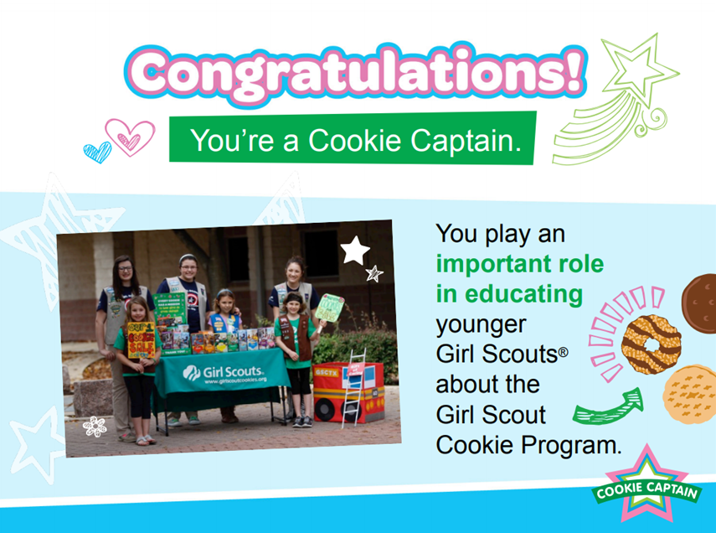
Push the Speaker
Notes:
First off, I want to say Congratulations for volunteering to be a cookie captain. You play an important role in educating younger girl scouts about the cookie program. After years of practice and learning, you now get to be a mentor to girls who are brand new at selling cookies.

Slide 3
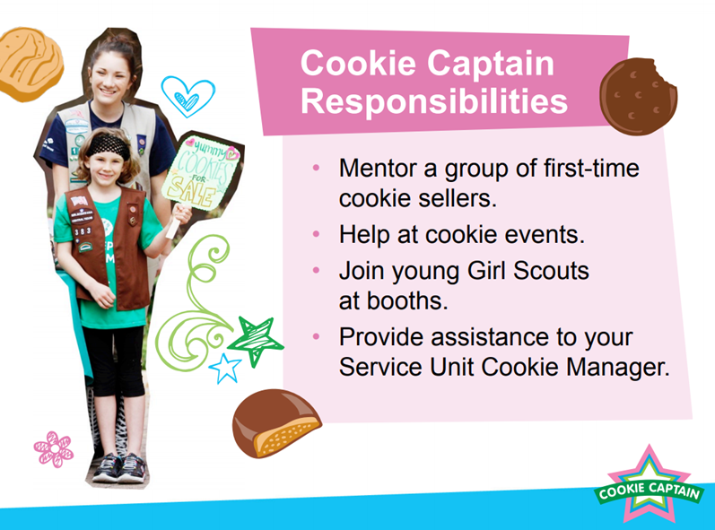
Required (Will Earn patch)
Required: Complete Cookie Captain Training found at girlscoutstoday.org/cookie sellers and watch this https://youtu.be/R6sxzMxxG1s
Required: Train A Cookie Rookie Troop: show video above as well to Cookie Rookie Troop https://youtu.be/TzzGXLqNmvk?list=PL6fWqsiT2B6ByeA47fPmQVoDLvHu36I_a
Turn in your Final Report by due date
Other Opportunities
Optional: Assist at Service Unit or Council Sponsored Cookie Rallies or at a Booth with Cookie Rookie Troop. ($5 VPC)
Optional: Help Cookie Rookies create and practice a Cookie Pitch ($5 VPC)
Optional: Assist a Cookie Rookie Troop reach a PGA of 250 ($10 VPC)
Optional: Help Cookie Rookies set up Digital Cookie and send out 15emails ($5 VPC)
Optional: Assist at for at least an hour at a Cookie Cupboard or Cookie Drop ($5 VPC)
Push the Speaker
Notes:
So – what are your responsibilities as a Cookie Captain? To help a Cookie Rookie Troop learn about the cookie program and develop the 5 entrepreneurial skills, while helping you develop leadership and teaching skills.
We have created 2 sections The first one is a requirement in order to become a cookie captain and earn the Cookie Captain Patch.
The second section will list optional opportunities available for you where you can earn extra program you to help with your Girl Scouting Experience.
Lets take a look. At those opportunities (read the list)
Assist at Service Unit or Council Sponsored Cookie Rallies or at a Booth with Cookie Rookie Troop. ($5 VPC)
Help Cookie Rookies create and practice a Cookie Pitch ($5 VPC)
Assist a Cookie Rookie Troop reach a PGA of 250 ($10 VPC)
Help Cookie Rookies set up Digital Cookie and send out 15emails ($5 VPC)
Assist at for at least an hour at a Cookie Cupboard or Cookie Drop ($5 VPC)
Remember all of these are optional you do not have to complete them all however if you do you can earn a total in $30 in program credits!
This list is available on the Final Cookie Captain Report that can be found on our website under Cookies for Sellers join a club
It is very important that you print out your final report and always have it on hand with you when you are completing an activity so that you can get a signature from the supervising adult and get credit for the activity completed. There is a due date to get the form in so make sure to mark your calendars and turn it in before the date listed on the bottom of the form.

Slide 4
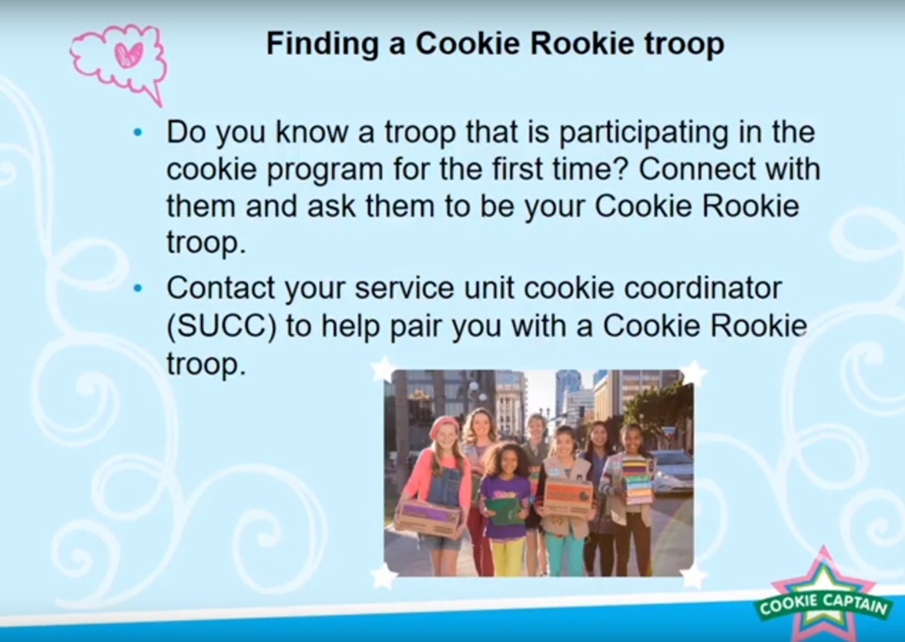
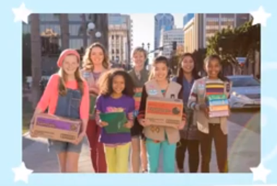
Do you know a troop that is participating in the cookie program for the first time? Connect with them and ask them to be your Cookie Rookie troop.
Contact your service unit product manager to help pair you with a Cookie Rookie troop.
Push Speaker
Notes:
Do you know a troop that is participating in the program for the first time? Maybe it’s a younger sister’s troop or a troop you know from school. You or your leader can connect with them and ask them to be your cookie rookie troop.
If you do not know any younger troops, then you or your troop leader should ask your service unit product manager to help pair you with a cookie rookie troop.
You may work together as a troop to train cookie rookies in a cookie rookie troop – girls can take turns leading the activities and role playing with the rookies.
If they are not able to pair you with a new troop, you can contact me and we will find a troop for you to work with – I will provide my contact information at the end of this training.

Slide 5

find
a Cookie Rookie Troop?
Contact your Troop leader, Local Service Unit Program Product Manager or reach out us at Shellig@girlscoutstoday.org
Push Speaker
Notes:
So how do you find yourself a cookie rookie troop if you haven’t already? This is a follow up slide to show who you should contact if you do not know a Cookie Rookie Troop to partner with.

Slide 6

Push Speaker
Notes:
Now lets take a look on how you will teach girls to sell cookies?

Slide 7
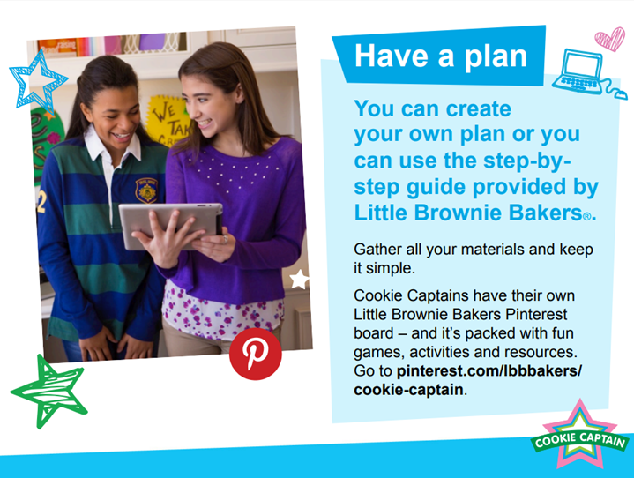
Visit Little Brownie Bakers at
https://www.littlebrowniebakers.com/Rallies
To see the Rally Guide and more!
Push Speaker
Notes:
Well – it’s very important that you start out with a plan.
Well – it’s very important that you start out with a plan.
You can create your own lesson plan of what you would like to teach your cookie rookies and what activities you would like to do. or you can use the items provided by Little Brownie Bakers to help guide you.
Remember keep it simple and Fun. Try to incorporate all of the 5 entrepreneurial skills within your leading. LBB has a Pinterest Page that can provide you will ideas for lots of crafts and games – and you can see the page at the bottom of the slide.
I will go over a few examples and ideas in the next few slides to help.

Slide 8
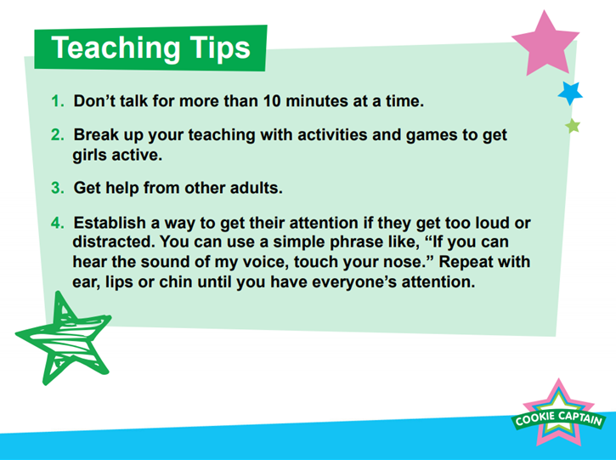
Push Speaker
Notes:
Here are some teaching tips for when you are working with your Cookie Rookies.
Don’t’ talk for more than 10 minutes at a time – if you do the girls will get antsy and stop listening – which means they will stop learning.
Try staggering the talking with activities,.
For example, you can talk for 5-10 minutes then complete an activity to go along with the topic that you were talking about.
Make sure that you get help from other adults at the meeting to keep the girls on track.
You can also establish a way to get the girls’ attention if they get too loud or distracted. At many GS events, someone will raise their hand until everyone quiets down.

Slide 9
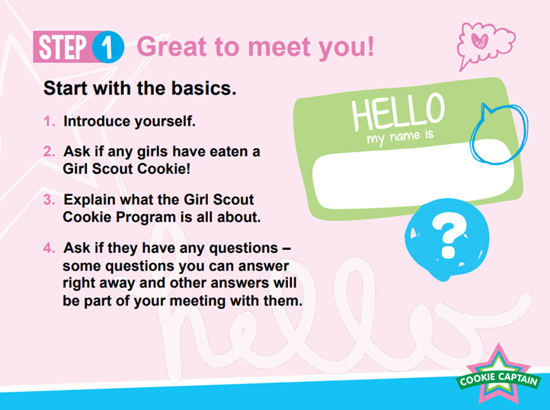
Push Speaker
Notes:
So here are some steps to help you are training your cookie rookies,
step one is to be sure to start with the basics.
It’s important for your cookie rookies to meet you and for you to meet them.
So introduce yourself. Then get everyone into a circle and ask their name, maybe how long they have been wanting to sell cookies and then another fun question such as their favorite GS cookie or if they could be any animal in the world – what would they want to be? The fun questions will help loosen up the cookie rookies and help them to be more comfortable to participate and ask questions during the training. Ask them if they have ever eaten GS cookie before. This way, you can see how familiar they are with the GS cookies in general.
Explain what the GS cookie program is all about. This is the time to get them excited about your training and excited about selling cookies.
Ask them if they have any questions. Some of the questions they ask you will be able to answer right away, but others you will want to wait because they will be answered in the rest of your training. So for example, if a rookie asks you, what are the names of all the cookies we are going to be selling, you can answer, that’s a great question and we are going to be covering that in our training today so I am going to hold off answering that until a little bit later.

Slide 10
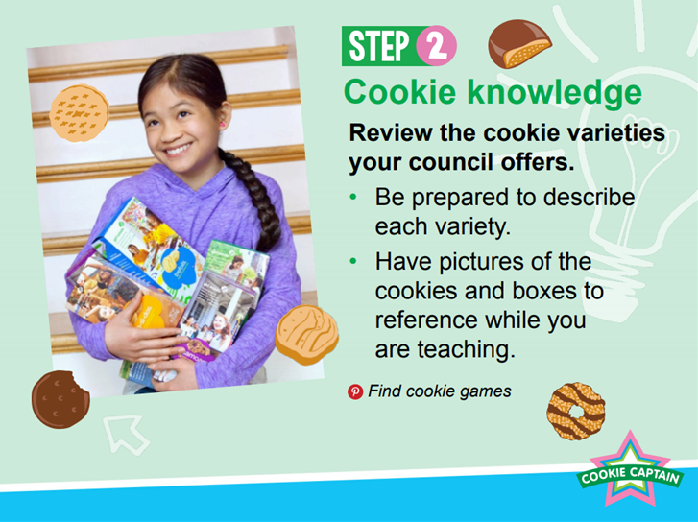
Push Speaker
Notes:
Step two is review the different cookie varieties with your cookie rookies so they gain the knowledge that they need in order to sell the cookies.
You want to make sure that you describe each variety to your cookie rookies that way they can describe it to their customers. You will need to explain the difference between our specialty cookies which are the Toffee Tactics and the core varieties – which are the Thin Mints, Samoas, Tag-a-longs, Do si Dos, Trefoils and Lemon Ups, Adventurefuls and Expoloremores.
But be careful if you do a Google search, because sometimes people accidently use out of date photos or photos of the wrong cookies. There are two different bakers and the names of the cookies are not the same at both bakers and neither are the ingredients.
So if you are having trouble finding up to date photos of cookies and cookie boxes, check out the clip art section of the LBB website or the Meet the Cookies section on our website www.GirlScoutsToday.org. I will show you screen shots of these pages on the next slide so you know where to find them. The LBB Pinterest page also has information about the cookies.

Slide 11
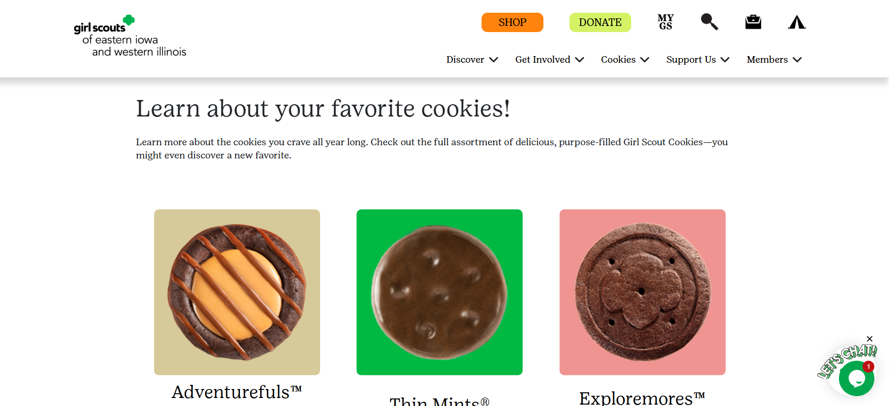
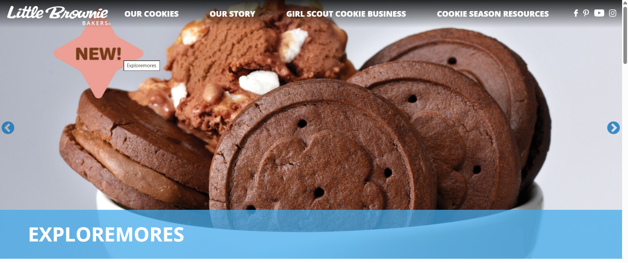
https://www.girlscoutstoday.org/en/cookies/buy-cookies/cookie-flavors.html
Push Speaker
Check out these links for resources to use when training your Cookie Rookie Troops!
https://www.littlebrowniebakers.com/
Notes:
Here is a screen shot of where you can find the Meet the Cookies section on GirlScoutsToday.org and also the Little Brownie Cookie Clip Art page.

Slide 12
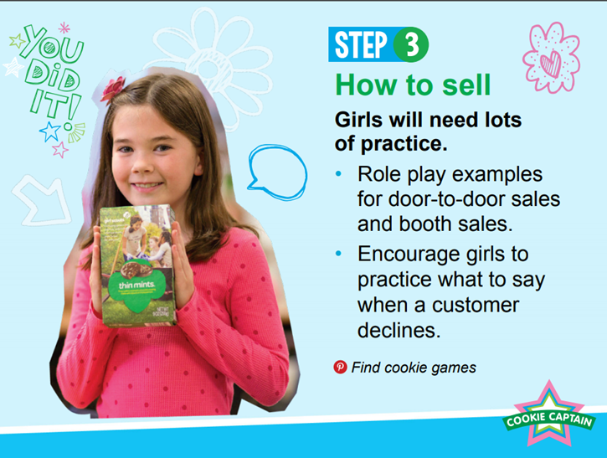
Push Speaker
Notes:
Step Three – teach the girls how to sell! And since this is their very first time, they are going to need a lot of practice.
First it will be good for the cookie captains to role play door to door sales and cookie booths. This way the cookie rookies can see how it’s done first. After you show a couple of examples, You can have the rookies practice in pairs. You can pair them up with each other or if you have enough captains at the training, you can pair them each up with a captain to practice.
The guidelines for door to door sales and booth sales can be tricky for first time sellers to understand so explain that a door to door sale means walking around in a residential neighborhood.
Playing an OK or not Ok game is a helpful way to drive these concepts home with your rookies. So you can say something like “is it OK to wake a wagon of cookies to sell at a soccer game- Ok or not OK?” If your rookies are wrong, that’s Ok you can just explain that it is Ok to sell cookies in wagon at a sporting event, as long as it is Ok with the event staff. Repeat the game with a few different examples, until you fee that the rookies have the guidelines down.
Don’t forget to practice what to say when a customer says no to buying cookies – ask if they would be interested in donating cookies to local heros and military and if they are still not interested, say thank you and move on. Remember that GS are courteous, courageous and strong!
Another thing to explain is how Digital Cookie can help them reach their goals. Even if you don’t help them set up their profiles at the meeting, you can explain why Digital Cookie is easy to use and helpful for reaching their cookie sale goals. You can offer to help set up the Digital Cookie accounts at the meeting ahead of time or come back to do it with the parents later.

Slide 13
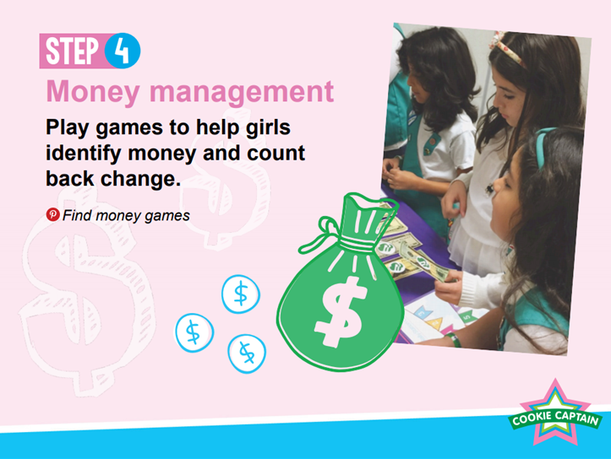
Push Speaker
Notes:
Step 4 is to teach your cookie rookies about money management.
You can play a game to help the cookie rookies recognize money and also help them make change.
You can play a money hide and seek game with your rookies. It may be too cold to go outside, but hide money around and allow the girls some time to find the hidden money. Once all the money is found, the girls can get back together to count how much you have.
You can also have them practice taking money when they are doing their role playing.
Don’t forget to talk about the different pricing of the specialty and the core cookies. The all cookies are $6 per package. They can look at their order cards to find the prices and descriptions of the cookies. You can also find more money games on the LBB Pinterest page or the little brownie bakers website.

Slide 14
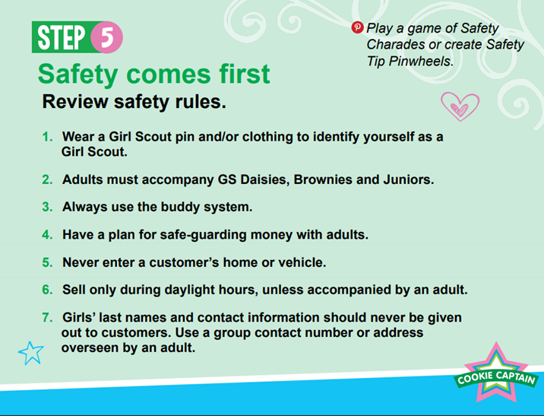
Push Speaker
https://www.girlscoutstoday.org/content/dam/girlscoutstoday-redesign/documents/Cookies/Cookie%20Booth%20Etiquette%20and%20Tips.pdf
Notes:
Step five is safety. Safety is very important so you want to make sure you go over the safety rules with your cookie rookies. (read the rules on the slide)

Slide 15
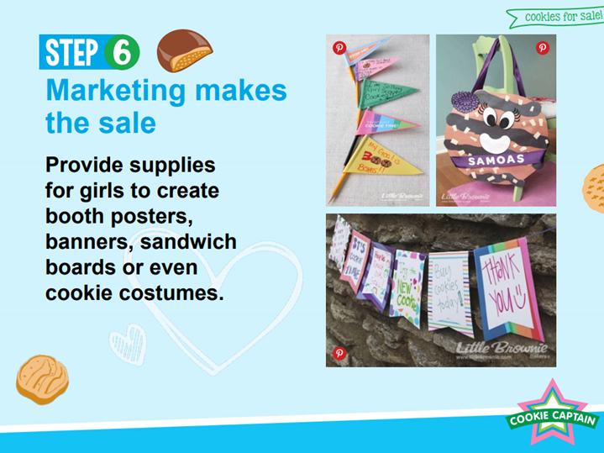
Push Speaker
Notes:
Step 6 – teach your girls how to market or advertise their GS cookies.
Be sure to tell them what techniques have worked for you and your troop in the past.
You can bring supplies for your cookie rookies to make posters, costumes or signs for wagons they might want to use for walkabouts or booth sales.
There are also lots of signs and advertisement on the little brownie website!

Slide 16
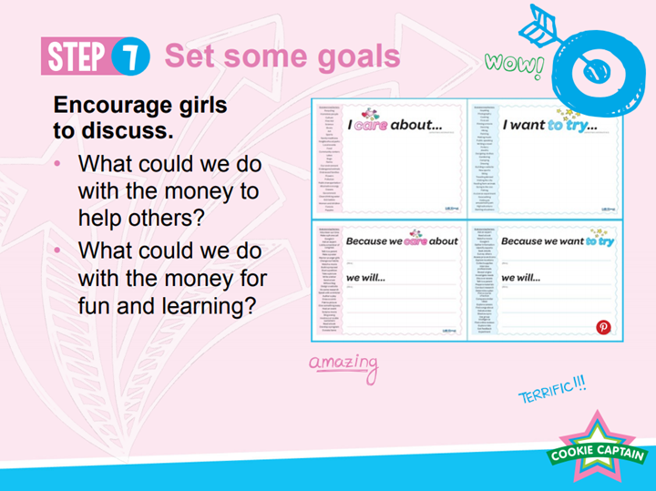
Push Speaker
Notes:
Step seven is to help your cookie rookies set goals and to understand why goal setting matters.
We know that setting goals is important because we also set up plans to reach them. So help them to brainstorm what they can do with their money from selling cookies.
Talk about what they can do to help others and also what they can do for fun and learning.
One idea to help your cookies set goals is for you to bring supplies to help them make a goal tracker. While your rookies are working to make a goal tracker, you can talk to them about what they are going to do to help reach their goals.
Maybe they will want to go to one booth sale a week or go out door to door every other day. Help them to brainstorm a plan that works best for them. You can find plenty of ideas for goal trackers on the LBB website

Slide 17
help
with a Cookie Rally?
Push Speaker
Notes:
Now let’s talk about cookie rallies –
in order to earn extra program credit, you can volunteer to help at cookie rallies.
Cookie Rallies are put on by your local Service Unit. Please have your troop leader reach out to the Service unit volunteer in charge of managing the Rally.
Remember to bring your final report to get signed
You can also reach out to a cupboard and volunteer at least one hour to help. Duties may include helping pull cookie orders for volunteers, or helping load cookies into cars. You can also help at the initial Cookie Drop. Contact a Cupboard or your service unit manager for more information.
There are also office cupboards in Burlington, Quad Cities, Waterloo and Cedar Rapids. If you would like to help at one of these locations please contact shellig@girlscoutstoday.org

Slide 18
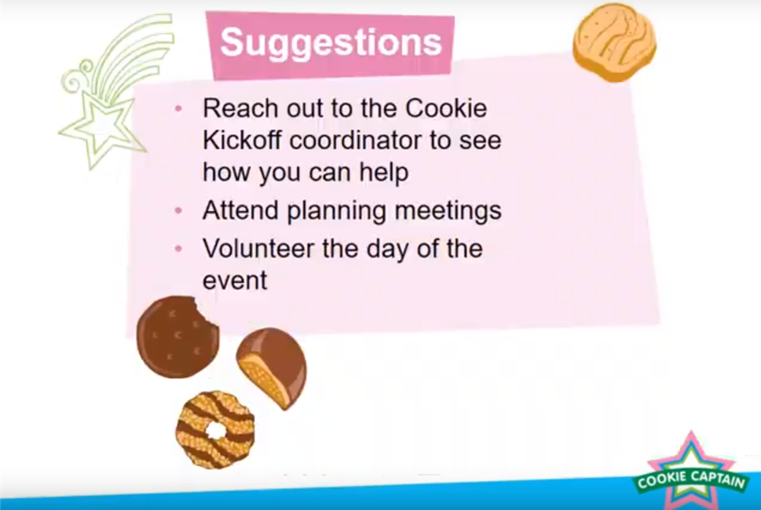
Service Unit Rallies
Reach out to the Service Unit Product Manager to see how you can help
Attend planning meetings
Volunteer the day of the event
Bring your Final Report to be signed
Push Speaker

Slide 19
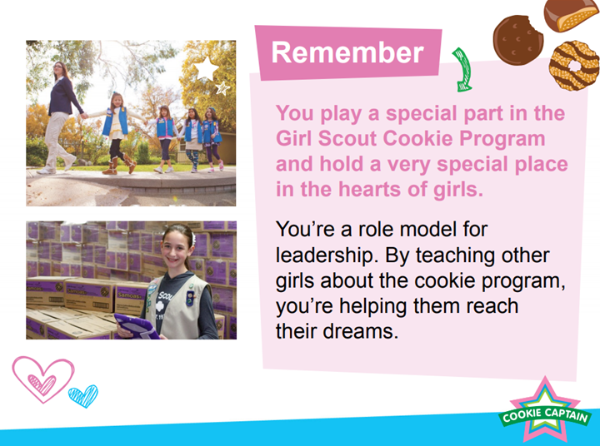
Push Speaker
Notes:
During your time as a cookie captain you play an important role in the cookie program and you will hold a special place in the hearts of the girls you will be getting to know.
You will be a role model for leadership. You are teaching young girls about the cookie program, you’re helping them reach their dreams!
Thank you for completing this training and Congratulations on Becoming a Cookie Captain!

Slide 20

Push Speaker
Notes:
Thank you so much for taking the time to complete this training-you are now ready to be a cookie captain and to train your cookie rookie troop! Go Cookie Captain Go!!

Slide 21
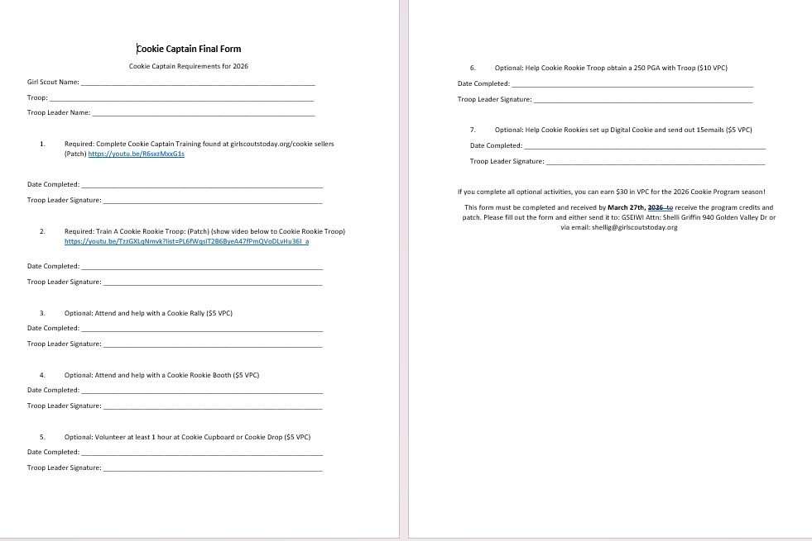
Final Report
Push Speaker
Form is located at www.girlscoutstoday.org
Under Cookies/Sellers/Join A Club
Notes:
Here is the final report that you will need to fill out to receive your program patch and optional program credits. This form is available to print on our website www.girlscoutstoday.org under Cookies, Then Cookie Sellers tab, scroll down to Join a Cookie Club and you will find link. This form must be send in by the due date to receive earned program credits.

Slide 22
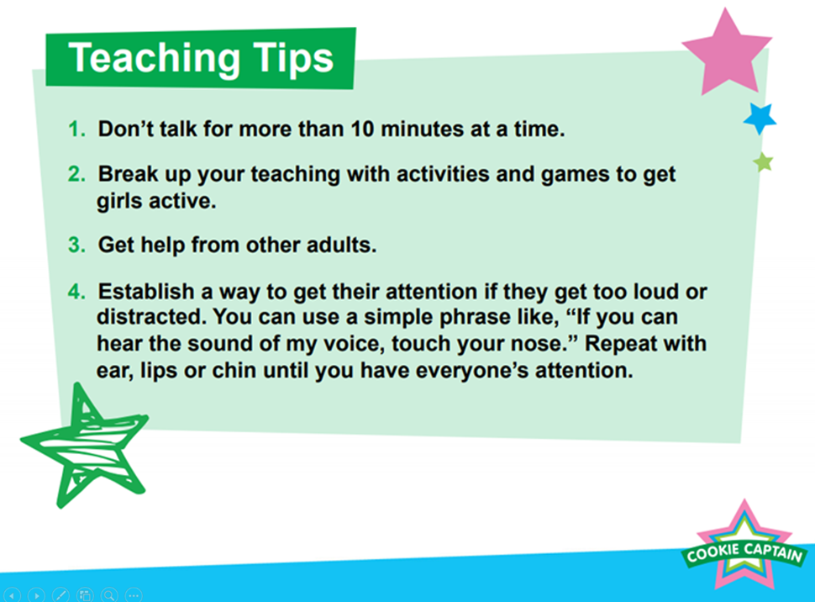
Final Steps
Make sure you have all the signatures from the necessary adults
Form must be completed and turned in no later than March 27th 2026 to receive patch and program credit
Questions? Shellig@GirlScoutsToday.org
Push Speaker

